Slide 1
Fuzzing: State of the Art
Sept 2018
Cited 4 times IEEE Transactions on Reliability
Hongliang Liang (Beijing University of Posts and Telecommunications)
Xiaoxiao Pei (Beijing University of Posts and Telecommunications)
Xiaodong Jia (Beijing University of Posts and Telecommunications)
Wuwei Shen (Western Michigan University, MI)
Jian Zhang (Institute of Software, Chinese Academy of Sciences,Beijing)
Presented by: Jeremy Solmonson
Class Project: CS 5371
7 Mar 19

Slide 2
Why I choose this paper?
Directly related to security
Directly related to my current research
Useful in finding unknown vulnerabilities that may be exploitable
It’s a survey paper
Collection of other people’s work
Uniquely organized to accomplish a goal
Helps future readers understand the topic

Slide 3
Overview
1. Introduction
1.0. Motivation
1.1. Interest within academia
2. The Fuzzing Process
3. White, Grey, Black-box Fuzzing
4. Problems within Fuzzing
5. Usable Fuzzers
6. Future work
7. Conclusion

Slide 4
1.0 Motivation – What is Fuzzing?
Let’s play a Game
Can you find the BUGS?

Slide 5

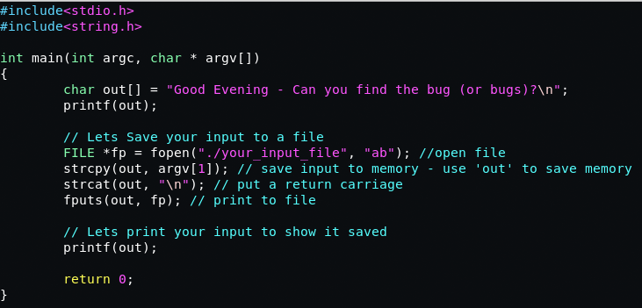
Program working correctly, right?

Slide 6
1.0 Motivation
Buffer Overflow
Doesn’t close file descriptor
String Format error
1)
2)
3)

Slide 7


1.0 Motivation
Buffer Overflow (Exploitable RCE)
Format String Error (Memory Leak)

Slide 8
1.0 Motivation
The Fuzz or
Uncheck input
Buffer Overflow (Exploitable RCE)
Format String Error (Memory Leak)

Slide 9
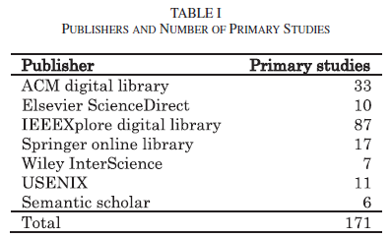
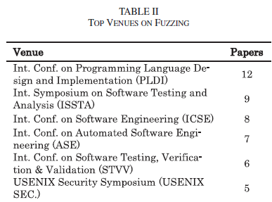
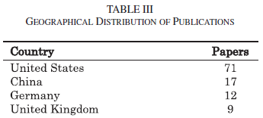
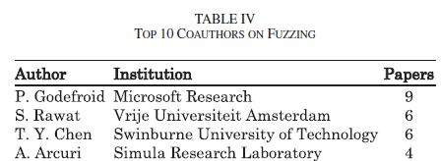
1.1 Interest within Academia

Slide 10
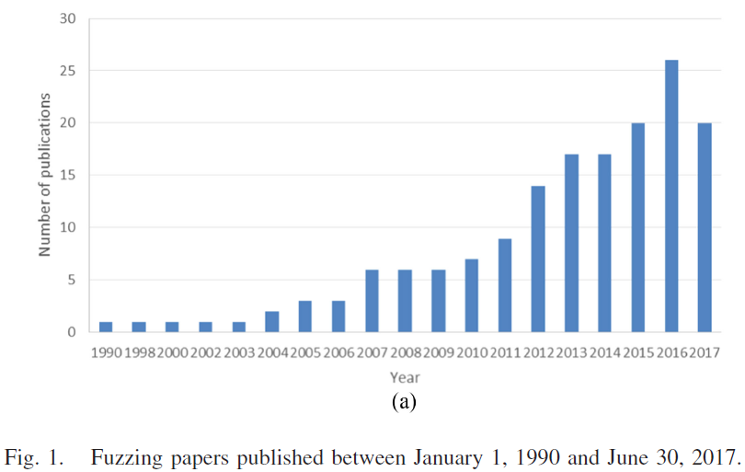
1.1 Interest within Academia
Research Questions:
1) RQ1: What are the key problems and the techniques in fuzzing research?
2) RQ2: What are the usable fuzzers and their known application domains?
3) RQ3: What are the future research opportunities or directions?

Slide 11
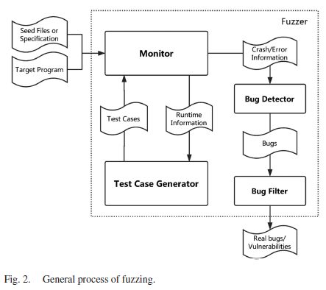
2. The Fuzzing Process
Target Program
program to test
Monitor
Observation of code (taint analysis, instrumentation)
Test Case Generator
Used for generating inputs
Mutation Based – uses seed file to rearrange inputs for testing
Grammar Based – generates inputs from specification
Bug Detector
collects inputs upon faults (stack traces)
Bug Filter
Finding only bugs that interest the tester

Slide 12
3. Black, White, Grey-box Fuzzing
Black-Box Fuzzing
No knowledge of the system
Usually use templates / seed files
Low code coverage due to random inputs
White-Box Fuzzing
Can cover all program paths (in theory)
Takes concrete input and solves for constraints
Usually doesn’t – many execution paths and constraints solver issues
Grey-Box Fuzzing
Uses subset of white-box information for fuzzing (such as):
Uses code instrumentation to obtain code coverage at run time
Uses taint analysis for tracing specific data inputs

Slide 13
4. (RQ1) Problems within Fuzzing
1) Seed Generation and Selection
Six kinds of selection algorithms
Set coverage algorithm from peach
A random seed selection algorithm
A minimal set cover (from greedy algorithm) ***
A minimal set cover weighted by size
A minimal set cover weighed by execution time
A hotset algorithm (run for time t, then rank the set)
Notable contributions
Heuristics performs better than random sampling
Unweighted minset performs best of the six above
A reduced set of seed files is more efficient than original set
A reduced set of seed files can apply to multiple applications

Slide 14
4. (RQ1) Problems within Fuzzing
2) Input validation and Coverage
Integrity Validation
Defeating checksums
Format Validation
Defeating communication protocols
Environment Validation
Defeat OS, version dependency, or one-off configs
Input Coverage
Defeating low coverage

Slide 15
4. (RQ1) Problems within Fuzzing
3) Crash induce test case handling
Comparing
Rank from most severe to least severe
Traditional clustering methods
Uniqueness
Thread call stack & address of fault causing instruction
Execution path of fault causing instruction
Exploitability
Usually requires code analysis tools (e.g. GDB)

Slide 16
4. (RQ1) Problems within Fuzzing
4) Runtime information and Effectiveness
Path Explosion
Toughest problem in symbolic execution
Due to the numerous possible branches
Imprecise Symbolic Execution
Constraint solvers yield improper results
Floating point inputs are common issues
Under-tainting
Data transmission is neglected for taint propagation
Over-tainting
Taint propagation to unnecessary variables

Slide 17
4. (RQ1) Problems within Fuzzing
5) Scalability in fuzzing
Find many “shallow” bugs in many programs (scalable)
Find many “deep” bugs in a few programs (efficient)
Application aware fuzzing
Reduce scope of the analysis
Cloud services for multiple platforms (mobile)

Slide 18
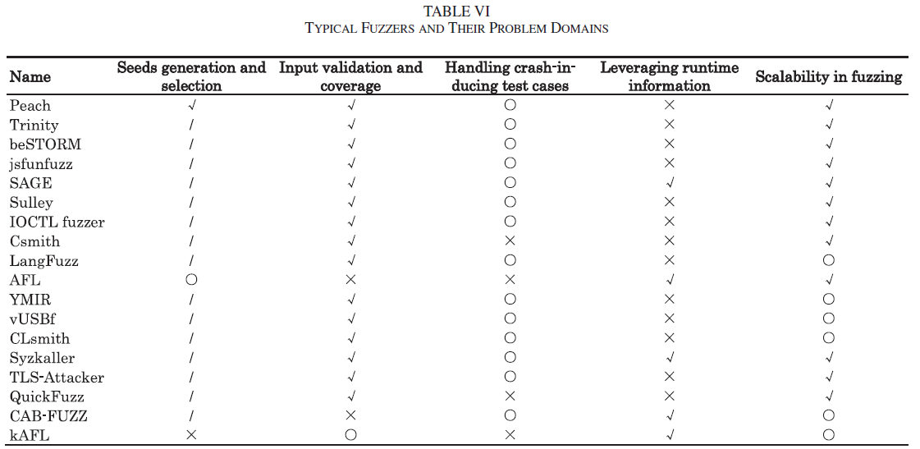

Slide 19
5. RQ(2) Usable Fuzzers
General purpose fuzzers
Modifiable to meet most scenarios
Fuzzers for compilers and interpreters
Create near real programs for assessment
Fuzzers for application software
Target specific OS and types of programs
Fuzzers for network protocols
Target programs that are available over the network
Fuzzers for OS Kernels
Target the kernel’s underlying functions
Fuzzers for Embedded Devices
Target mobile, drivers, or components

Slide 20
6. (RQ3) Future Work
Input validation and coverage
Generate inputs that meet specification and bypass validation
Smart fuzzing
Path explosion, imprecise symbolic execution, over/under tainting
Filtering fuzzing outputs
Classifying and prioritizing found bugs
Seed/Input generation and selection
Generating or mutating inputs to gain coverage/efficiencies
Combining different testing methods
Use various combinations of testing in unique ways
Combining other techniques with fuzzing
Focus attention on untested code or adapt machine learning

Slide 21
7. Conclusion
Great overview on fuzzing
Summarized 171 papers
Explained trends and similarities within academia
Focused on future work
Examined problem within fuzzing applications
Elaborated on usable tools and their purpose
Listed trending areas of working within fuzzing

Slide 22
Questions or Comments ?? || //
“Education is what remains after one has forgotten what one has learned in school.” - Albert Einstein

